Slide 1
Calendar Assessment
CLI Calendar Management Application in Java
By: Alex Schatz

Slide 2
Approach & Desing
Create a CLI Calander management application
Focus on days to encapsulate events for easy access
Events are stored in a day, Days are stored in a Month
User interaction is managed with the CommandInterface Class
Notes:
Mention how the logic for finding the next possible time slot proved more challenging than expected

Slide 3
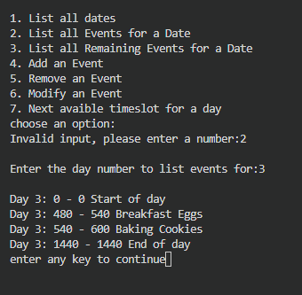
Key Features
View days and event counts
View all events for each day
Add, remove and modify any event
Avoid schedule conflicts
Find available time slots
Input validation

Slide 4
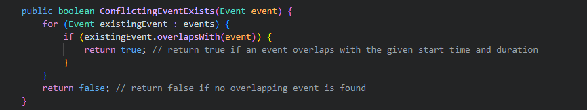
Conflict detection
prevent overlapping events from being scheduled
If a conflict is detected, the user is prompted to enter a different time.
Also avoids conflicts when modifying start time and end times for events

Slide 5
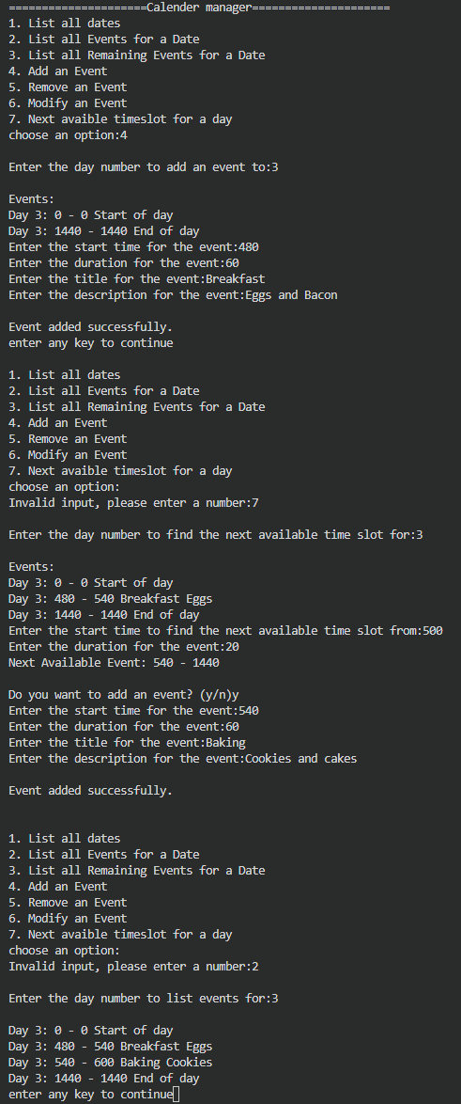
How to run
Compile
javac .\src\*.java
run
java .\src\CommandInterface.java

Slide 6
Future Improvements
Save and Load Calendar
Support Real Calendar Dates and Years
Add Recuring Events
Add Event Categories
Exports schedules to CSV or JSON
Improve Time and Display using HH:MM Formatting
Utile RealTime such as the Java Date and Time API

Slide 7
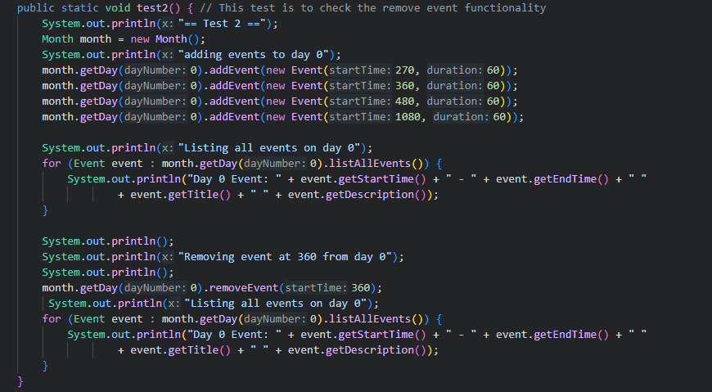
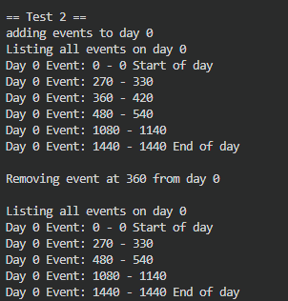
Testing
Test 1: Event Listing — Verify chronological ordering and filtering → PASS
Test 2: Event Removal — Verify events are removed and ordering remains intact → PASS
Test 3: Conflict Detection — Verify overlapping events are rejected → PASS
Test 4: Event Modification — Verify titles and descriptions can be updated → PASS
How to Run Tests: Execute java .\src\ Test.java

Slide 8
Learning Outcomes
Object-Oriented Programming principles
Data management using custom classes
User input handling and validation
Event scheduling algorithms
Conflict detection and resolution
CLI application development in Java

